Slide 1
Analysis of Healthcare and Congress
Joe Garcia

Slide 2
Research Question:
Is the age of congress increasing as time goes by?
Does healthcare in laws increase as congress age increases?

Slide 3
Data
- From FiveThirtyEight, collected from Voteview.com and the U.S. House of Representatives. For my second Data set, I chose congress.gov, and scraped key elements from their search engine.
- https://voteview.com
-https://raw.githubusercontent.com/fivethirtyeight/data/master/congress-demographics/data_aging_ congress.csv
-https://www.congress.gov/quick-search/legislation?wordsPhrases=health+care&wordVariants=on&congressGroups%5B%5D=0&congresses%5B%5D=all&legislationNumbers=&legislativeAction=100&sponsor=on&representative=&senator=&q=%7B%22congress%22%3A93%7D

Slide 4
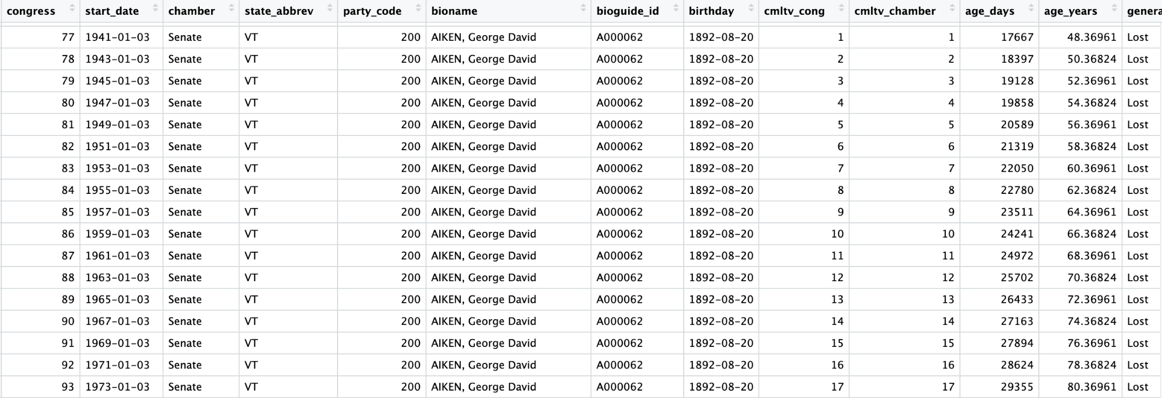
Data
The Fivethirtyeight data was very clean and tidy, we only used these 3 particular columns in our exploration.

Slide 5
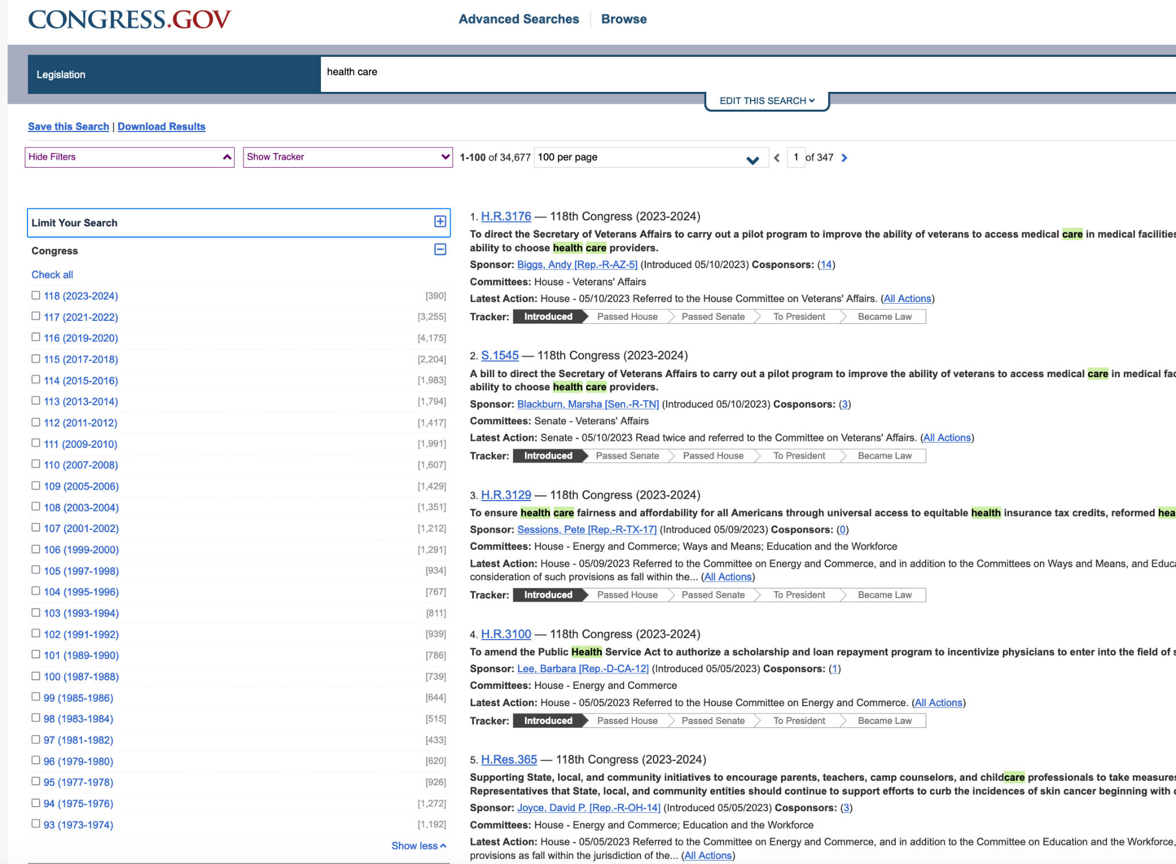
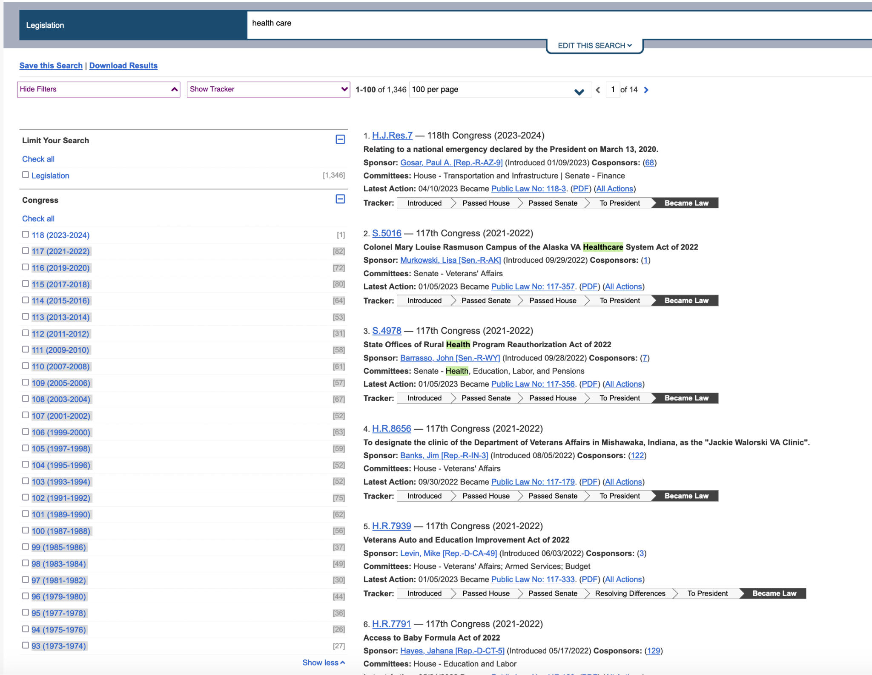
Data
Using the healthcare filter, we are given a robust data set. We have two subplots that we have extracted out of them the introduced laws and the became law.

Slide 6
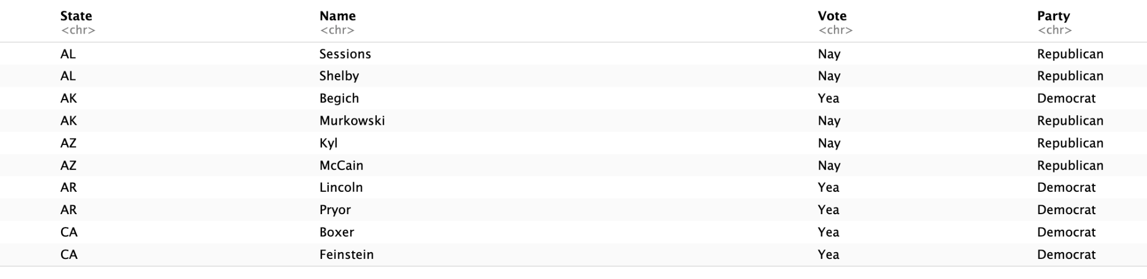
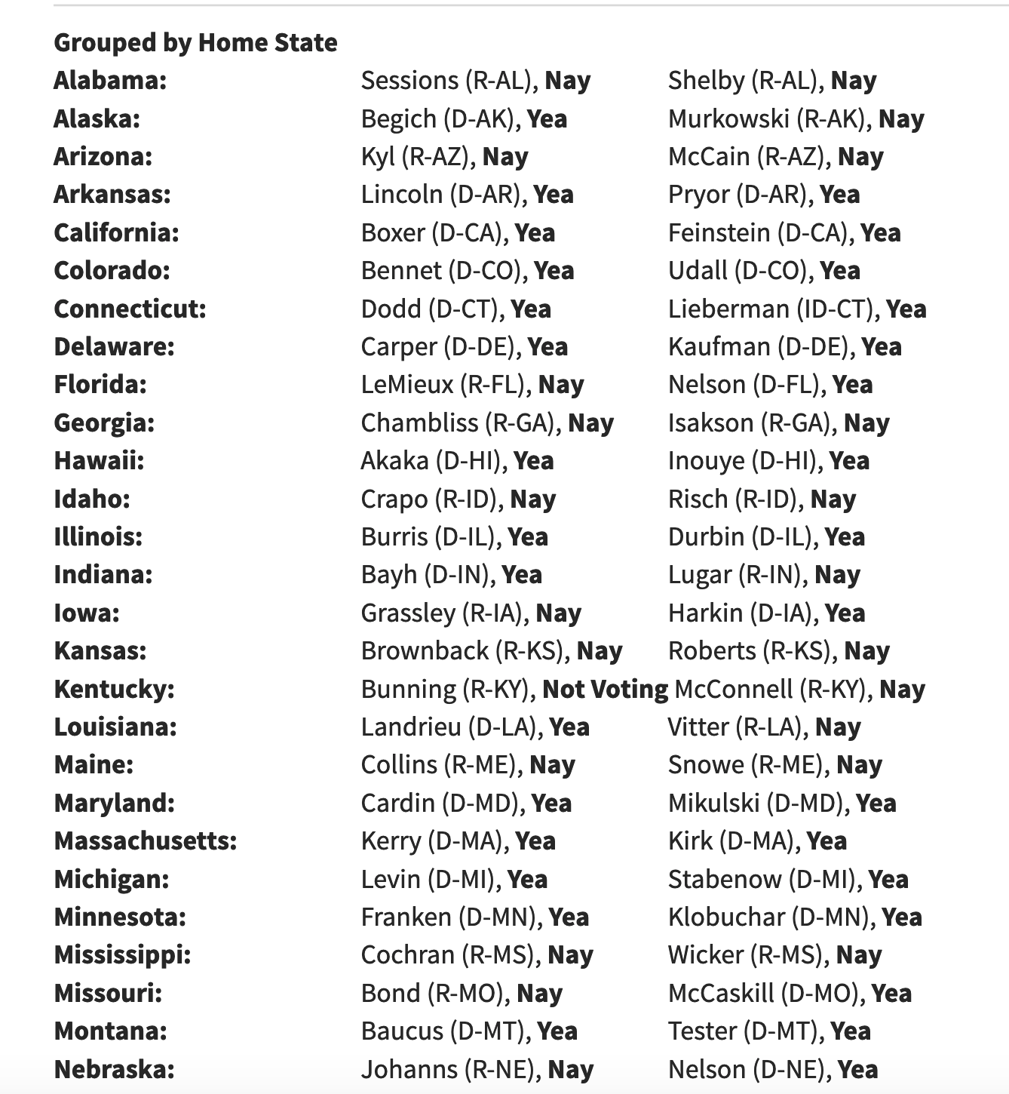
Case Study: ACA, Bill Number H.R. 3590
Data
Scrapped the data from the Affordable Cares Act, cleaned and tidied the data.

Slide 7
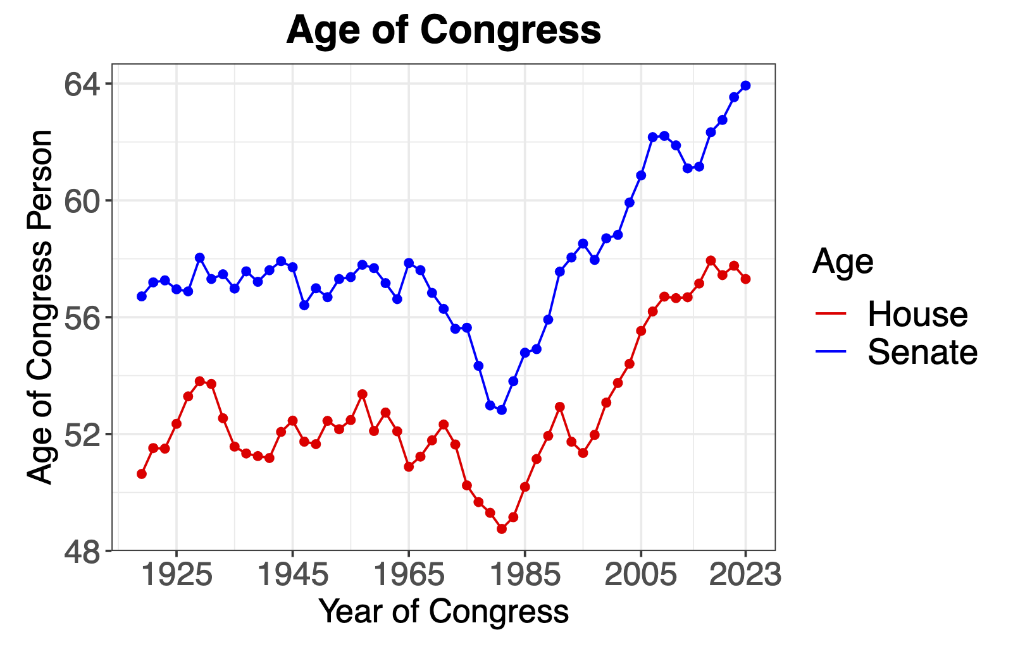
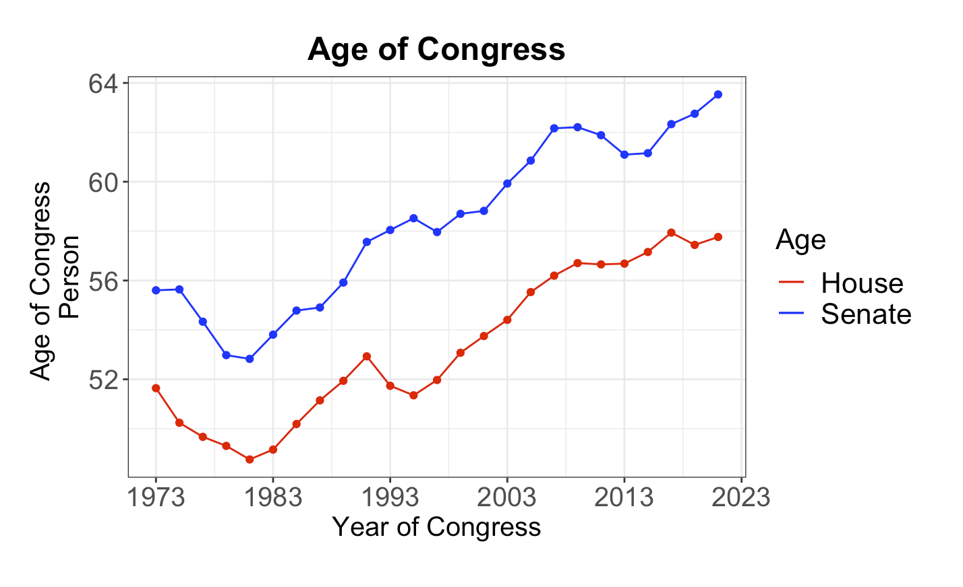
Data Visualization
We are able to confirm the age of congress throughout the years. We limit the year span so that it would reflect the same time period as the extracted data.

Slide 8
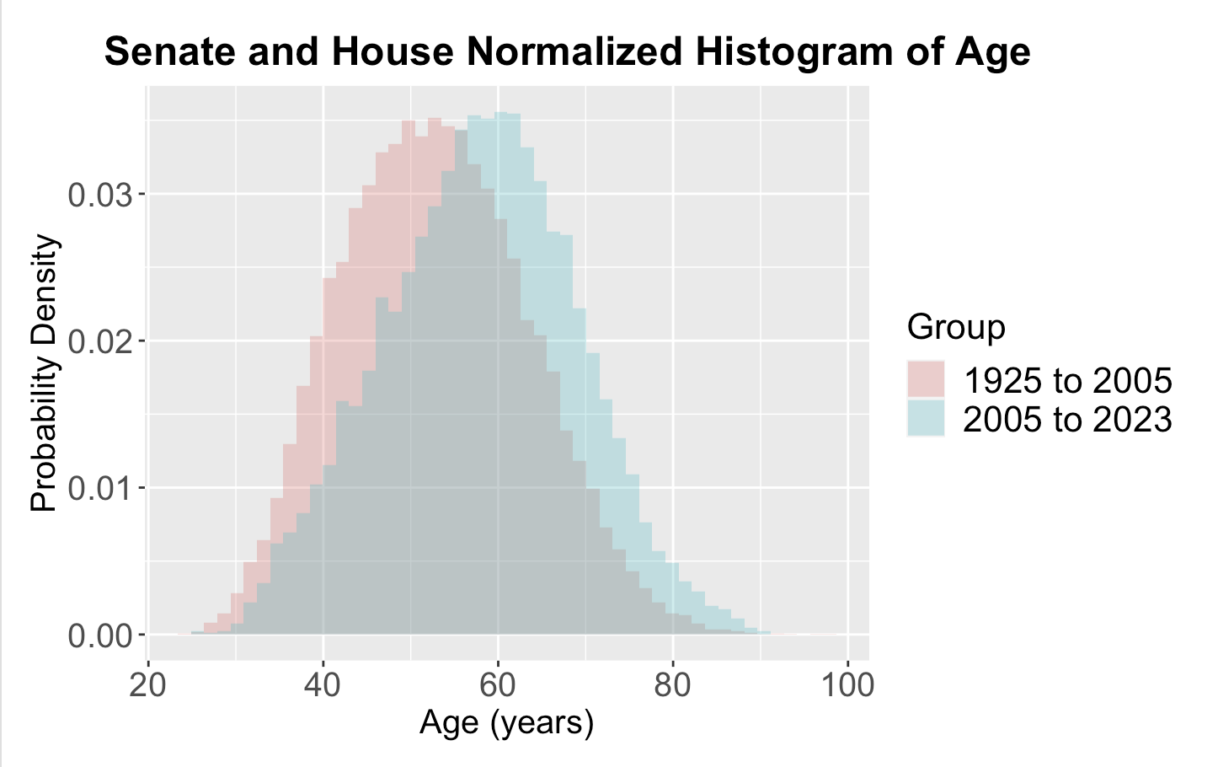
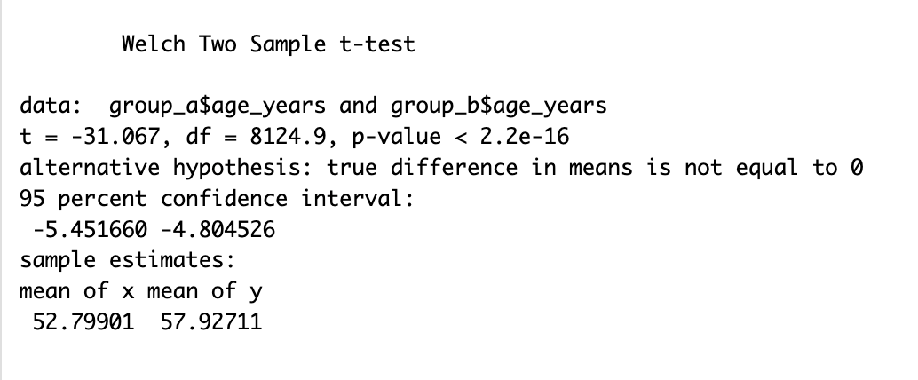
Analyzing Data
We discover that there is a significant difference between the two time periods.

Slide 9
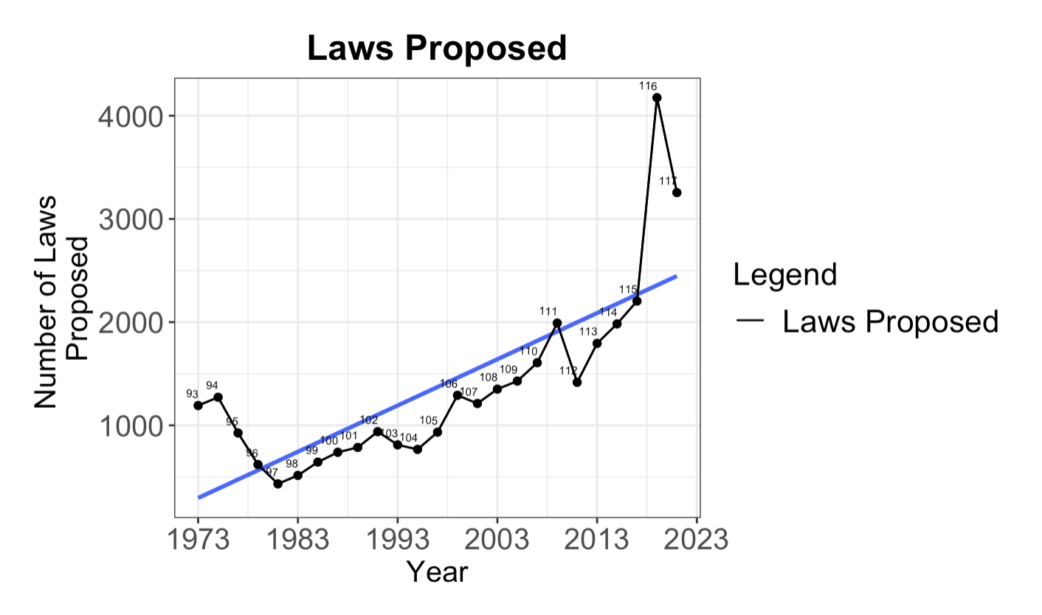
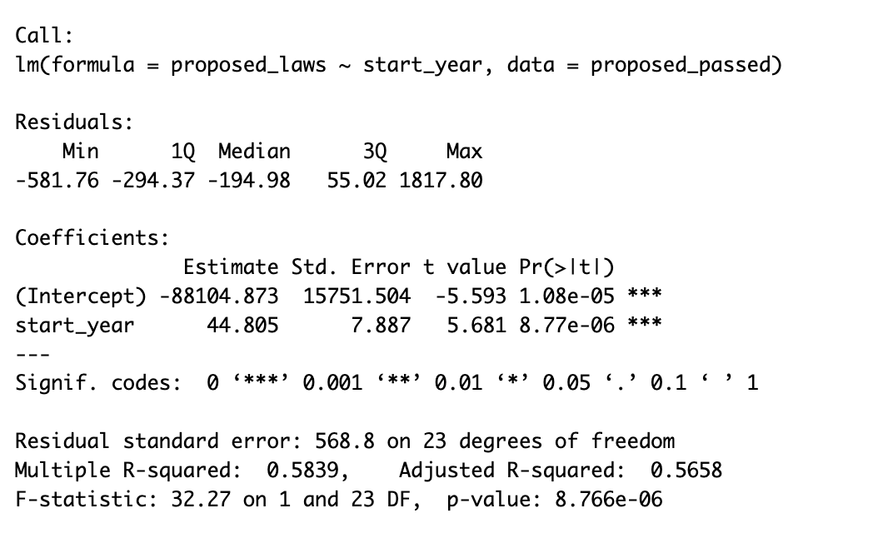
Analyzing Data
There is a significant increase in how many laws were proposed as the linear model suggests. In congress 116 nearly 4200 laws proposed.

Slide 10
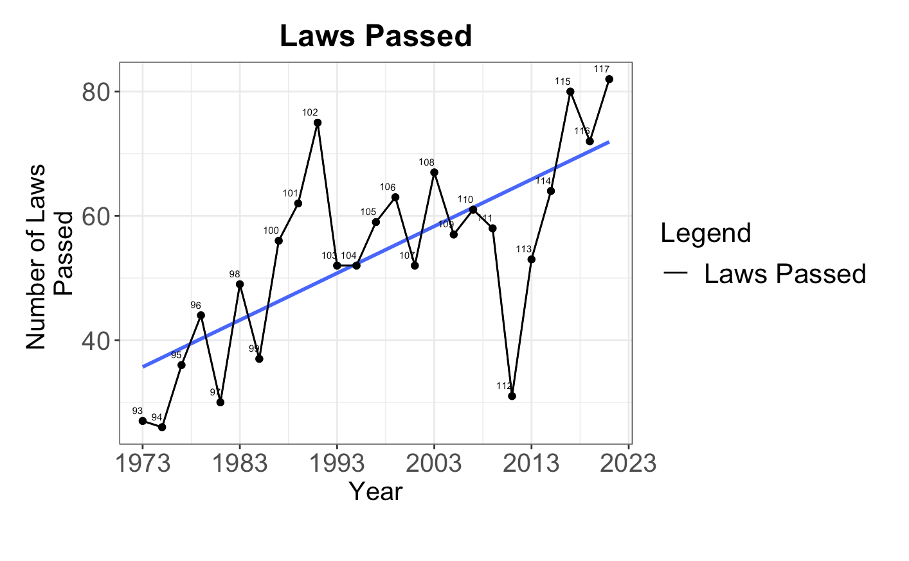
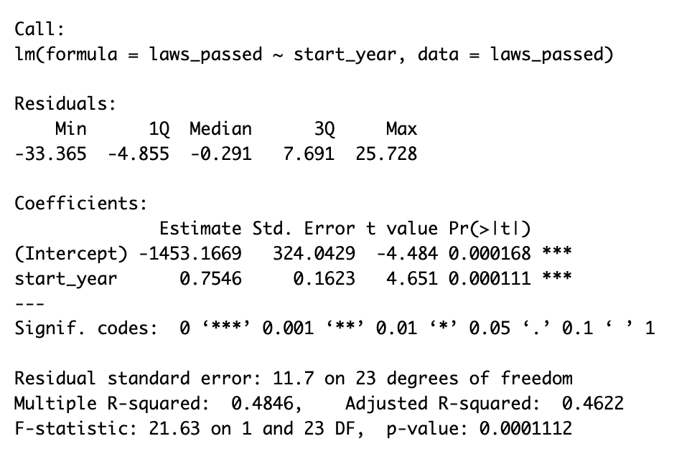
Analyzing Data
Still a significant number in the overall number of laws passed, however it has slid down from congress 116, 4200 to merely around 70!

Slide 11
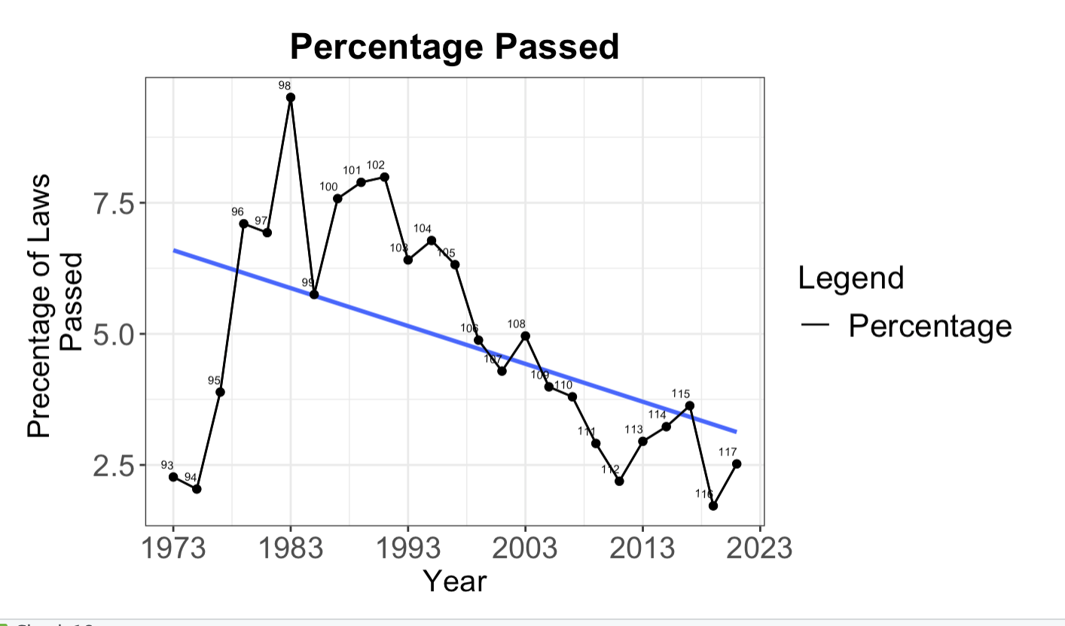
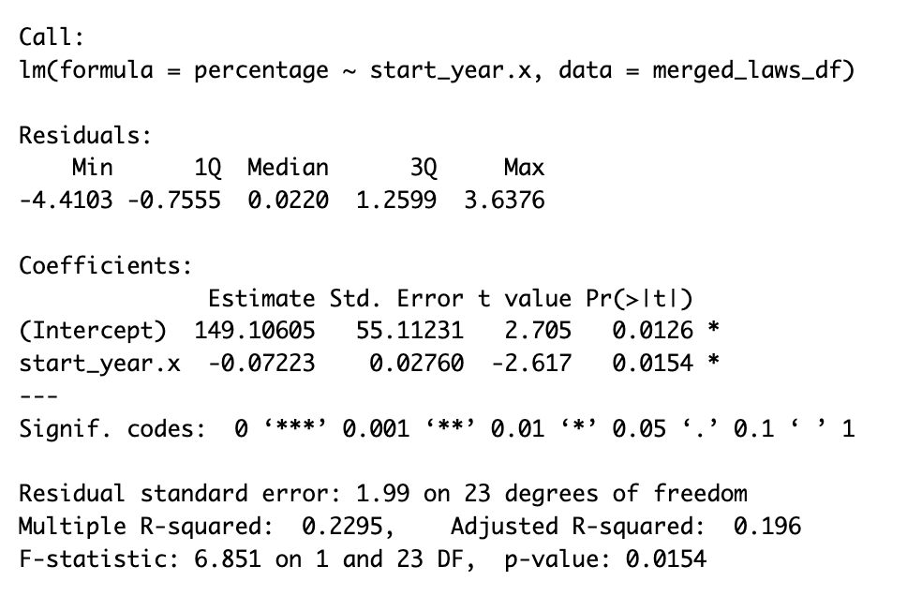
Analyzing Data
This graph shows us that the percentage of laws has continually gone down, although the number of laws being passed has risen. This suggest less working together in congress.

Slide 12
Analyzing the Data

Slide 13
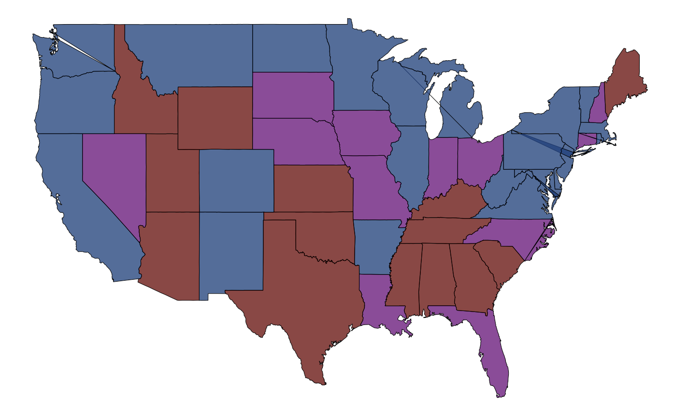
ACA voted by the Senators using ggmap
This map shows the senators that voted for the ACA act in 2010. The blue represents that both senators have voted Yea, the red suggests they have both voted Nay, and the purple represents a mixed outcome.

Slide 14
Hypotheses Answer:
- The age of congress is show to be significantly different from the past 1923- 2005 and the recent grouping of 2005 - 2023
- We have found that through a linear model, that there is a increase in the number of laws being passed, however there is a decrease in the percentage of laws passed from the past.

Slide 15
THANK YOU!
Joe Garcia

